Slide 1
Managing and Tracking the Software Project
Not every group is a team, and not every team is effective. Glenn Parker
If you want to be incrementally better: Be competitive. If you want to be exponentially better: Be cooperative

Slide 2
Questions from a Customer
Do you understand my problem and needs?
Can you design a system to solve my problems or satisfy my needs?
How long will it take to develop the system?
How much will it cost to develop the system?

Slide 3
Project Planning
Before starting
Establish system’s scope and objectives
Consider alternative solutions
Identify technical and management constraints
As a Project Manager
Decompose the product function (FD)
Select an appropriate process model
Select the task set for the project
Decompose the tasks into smaller work items (WBS)
Estimate effort for each task/work item
Estimate completion time of the project (Task/Activity Network)

Slide 4
Project Schedule (Contd.)
Understanding customer’s needs by listing all project deliverables
Documents
Demonstrations of function
Demonstrations of subsystems
Demonstrations of accuracy
Demonstrations of reliability, performance or security
Determining milestones and activities to produce the deliverables

Slide 5
Project Schedule (Contd.)
Activity: takes place over a period of time
Milestone: completion of an activity -- a particular point in time
Precursor: event or set of events that must occur in order for an activity to start
Duration: length of time needed to complete an activity
Due date: date by which an activity must be completed

Slide 6
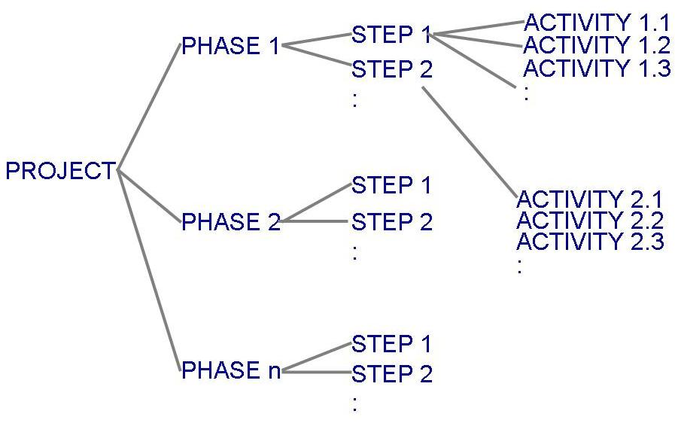
Project Schedule (Contd.)
Project development can be separated into a succession of phases which are composed of steps, which are composed of activities (Work Breakdown Structure)

Slide 7
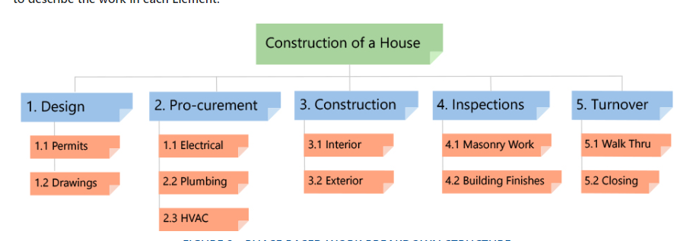
Work Break Down Structure(Contd.)
Work breakdown structure depicts the project as a set of discrete pieces of work

Slide 8
Activity Networks
Activity networks depict the dependencies among activities
Activity networks can be of two types
AoA: Activity on Arc
AoN: Activity on Node

Slide 9
Project Types
Concept Development
To explore new business concept
New Application Development
As a consequence of specific customer request
Application Enhancement
Modifications to existing functions, performance, interfaces of software; observable by the end user
Application Maintenance
Correct, adapt, extend existing software; not immediately obvious to end user
Reengineering Projects
Redevelop an existing system

Slide 10
Concept Development Projects
Usually initiated to explore some new business concept or application of some new technology
Task set might be like:
Scope the concept
Develop preliminary plan of the concept: develop the ability to undertake the work
Assess the technology risk
Develop proof of concept
Implement the concept
Get customer feedback

Slide 11
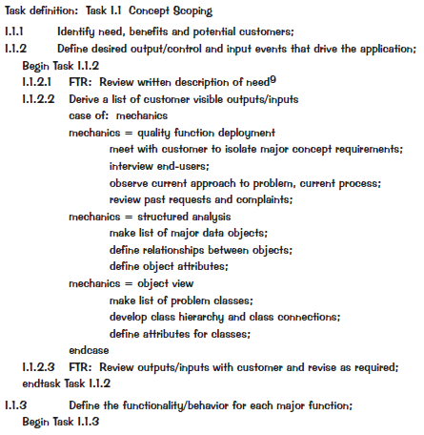
WBS for CDP

Slide 12
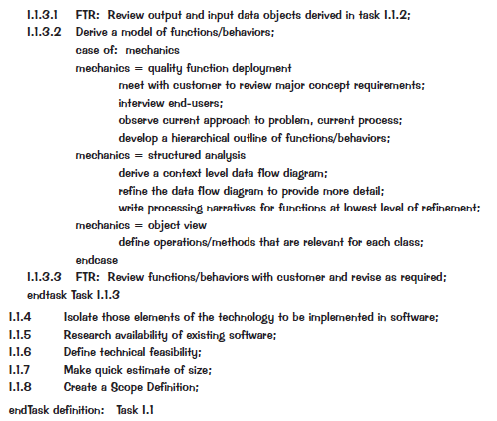
WBS for CDP (Contd.)

Slide 13
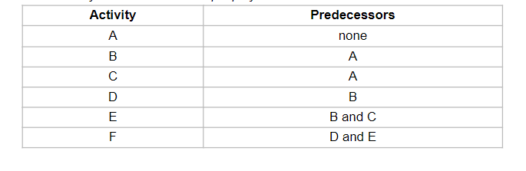
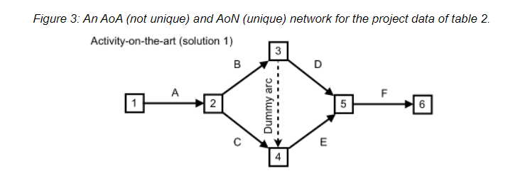
Activity on Arrow(AOA)

Slide 14
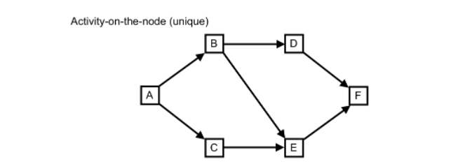
Activity on Node(AON)

Slide 15
Estimating Completion Critical Path Method
Minimum amount of time required to complete a project
Reveals those activities that are most critical to completing the project on time
Real time (actual time): estimated amount of time required for the activity to be completed

Slide 16
Estimating Completion Critical Path Method
Earliest Finish =Earliest Start+duration
Latest Start=Latest Finish-Duration
Slack time = Delayed time
Formulae=Latest Finish-Earliest Finish
Critical path: the slack at every activity is zero
can be more than one in a project schedule

Slide 17
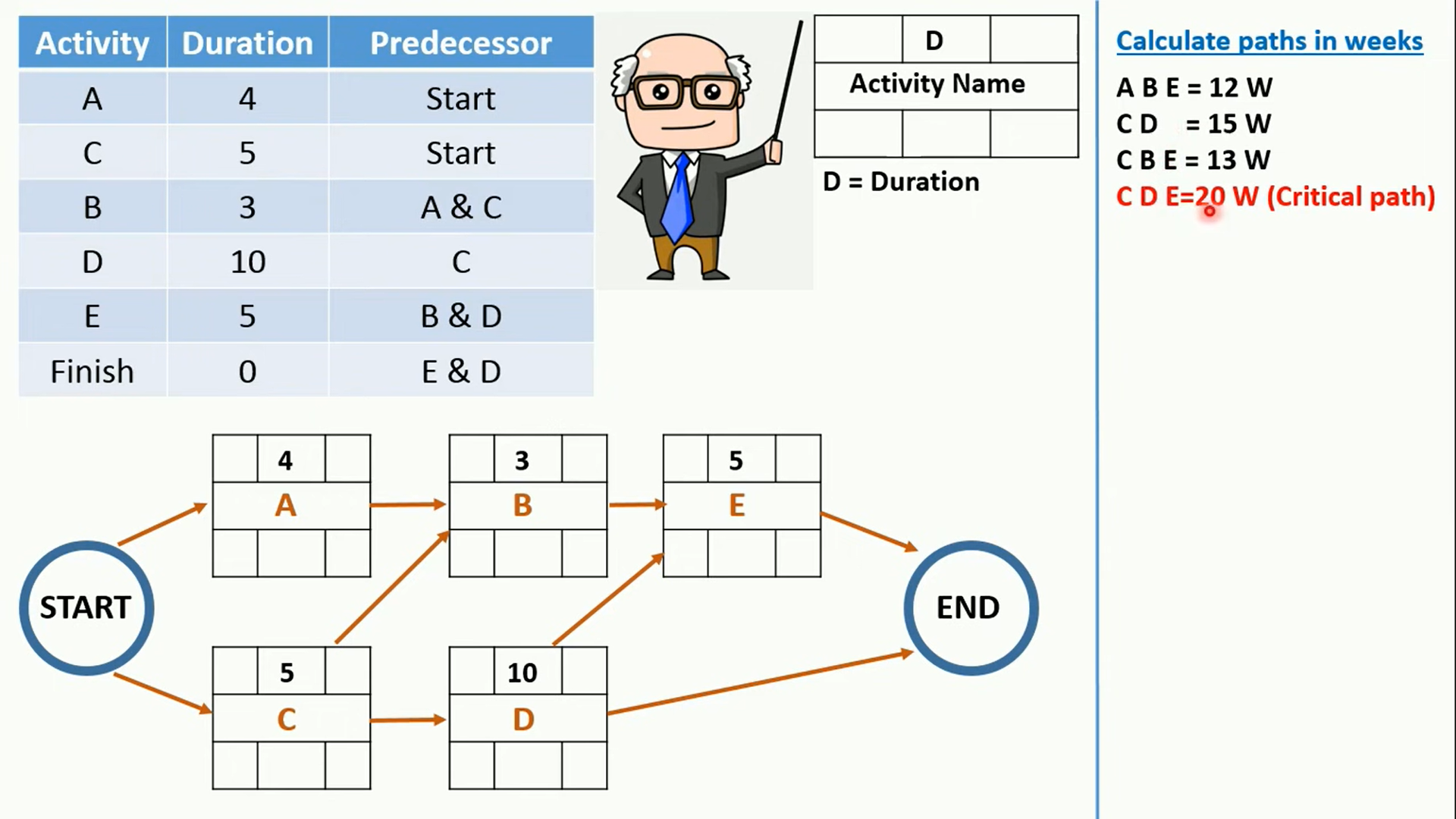
Program Evaluation Review Technique (PERT) Chart/ Critical Path Method

Slide 18
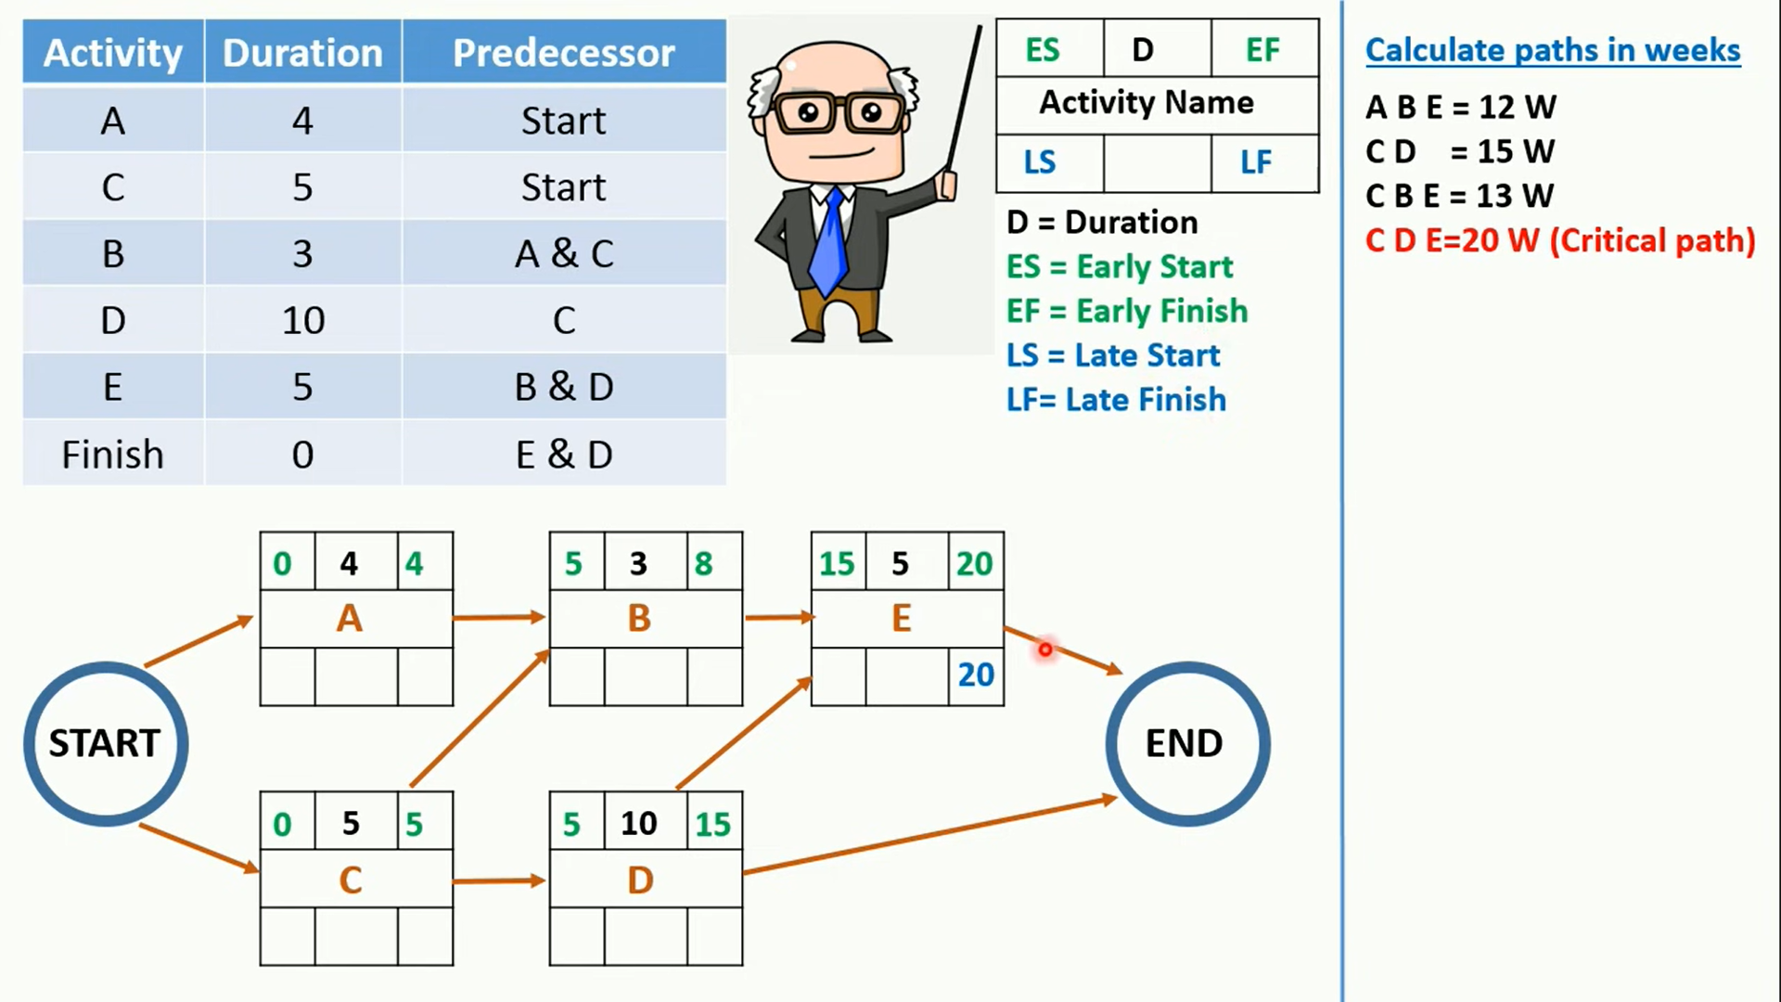
Critical Path Method

Slide 19
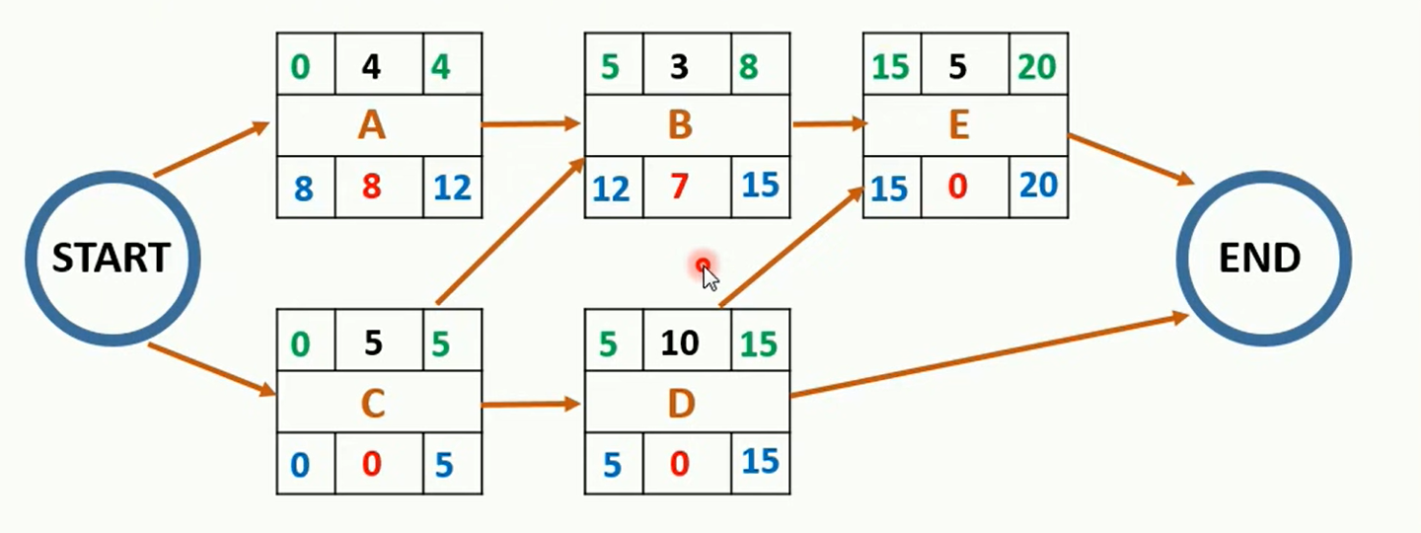
Critical Path Method

Slide 20
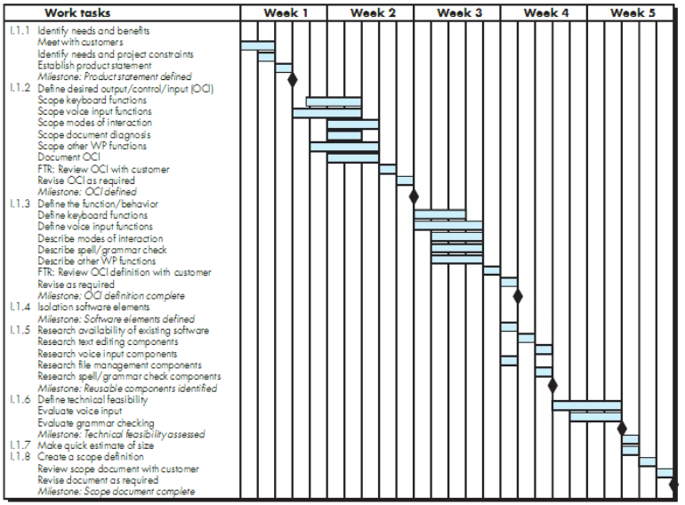
Gantt Chart

Slide 21
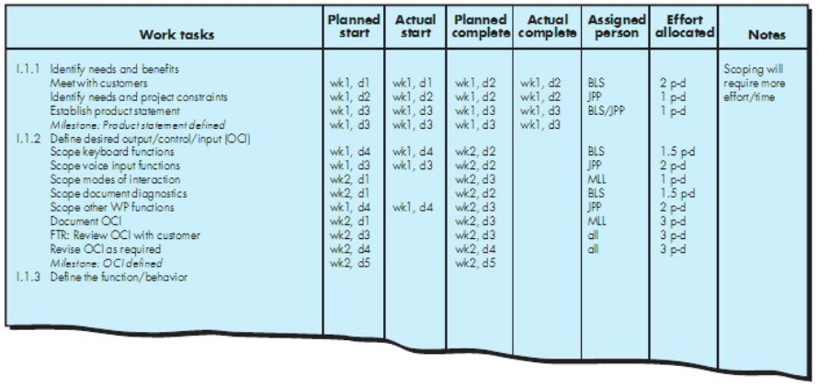
Gantt Chart

Slide 22
References
Pfleeger SE Book
Pressman SE Book
Acknowledgement
A few slides have been reused from UCF slides for the SE course

